Slide 1
CO2301 - Games Development 1
Week 12
Interpolation, Path Smoothing & Splines
Gareth Bellaby

Slide 2
Topics
Introduction - Path Smoothing
Parametric line equations
Interpolation
Path Smoothing & Splines

Slide 3
Topic 1
Introduction - Path Smoothing

Slide 4
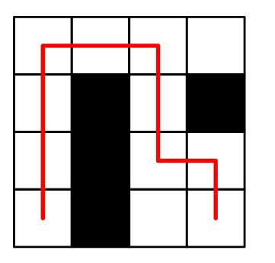
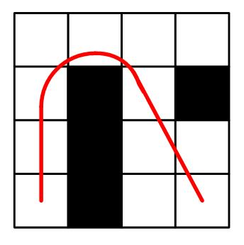
Path Smoothing
The path generated by the pathfinding algorithms are composed of unnatural looking straight lines and abrupt turns. This is true whichever representation is used.
Path Smoothing is about smoothing the path and making something more aesthetically pleasing.

Slide 5
Path Smoothing
We have a set of points.
We want to instead to have a curved path or line.
One way to do this is so employ a spline. A spline takes two or more points and draws a curve based on the location of the points.
The word spline is an architectural term- it was a flexible wooden rod used to draw out a curve, e.g. for a pillar section.
There are different types of spline. The curve they generate have different characteristics.

Slide 6
Topic 2
Parametric line equations

Slide 7
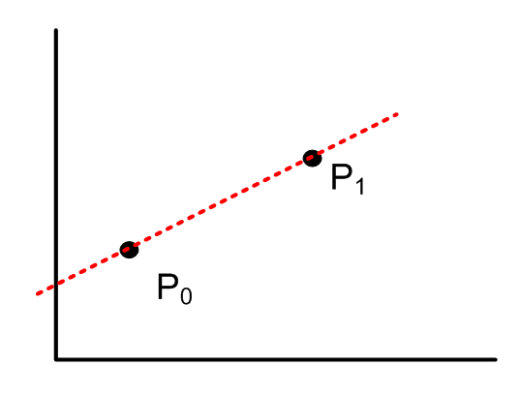
Parametric equation
A parametric equation is simply one that contains a parameter.
In this context, the parameter means a variable.
Two points are needed to calculate the equation for a line.

Slide 8
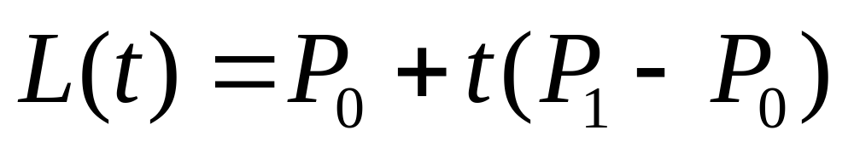
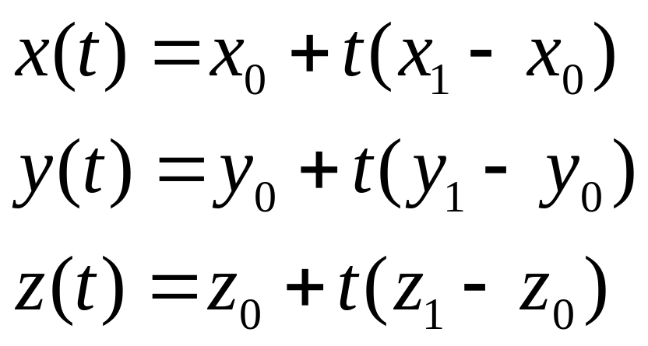
Parametric equation
One convention is to use t for the parameter.
All of the points lying along a line can be expressed using the following formula:
In practice you will express each of the x, y and z components separately, e.g.

Slide 9
Parametric equation
P₀ is the point where the line starts.
P₁ - P₀ is simply the vector (or slope) between two points.
t is a variable which ranges across all of the possible points along the line.

Slide 10
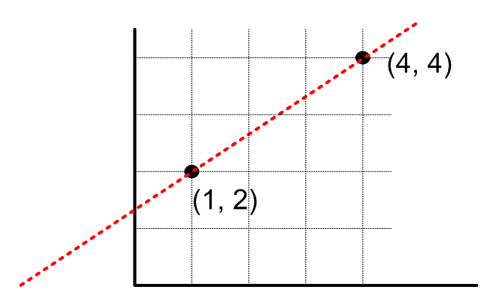
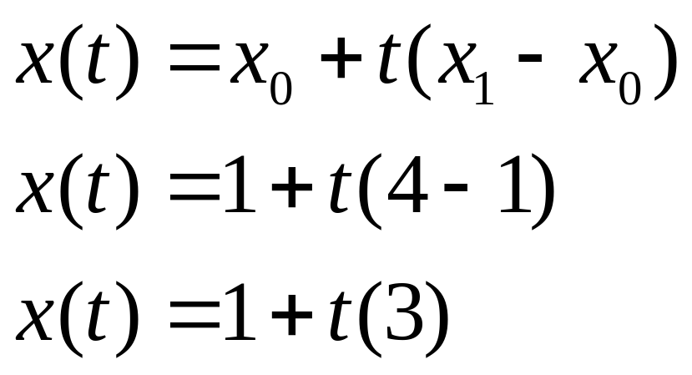
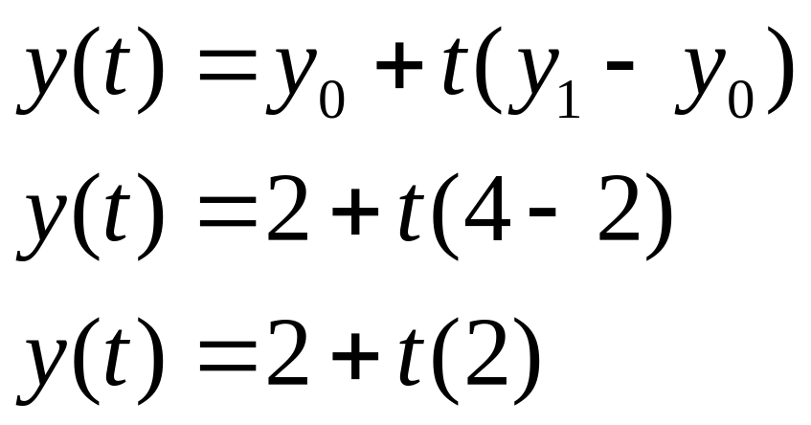
Example

Slide 11
Intervals
Note that the parametric line equation can be used to derive regular intervals along the line.
The half-way point is calculated if t = 0.5.
The quarter-way point is calculated if t = 0.25.

Slide 12
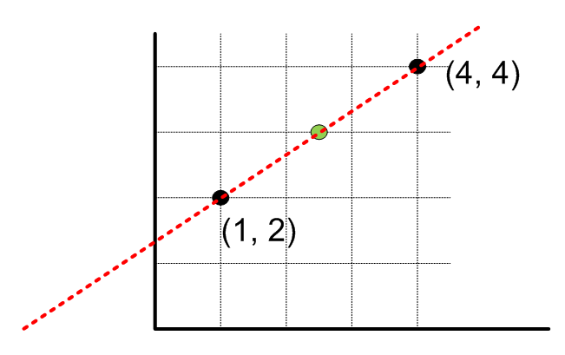
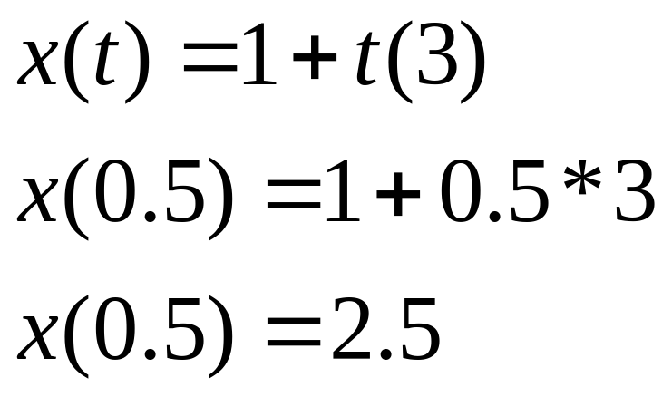
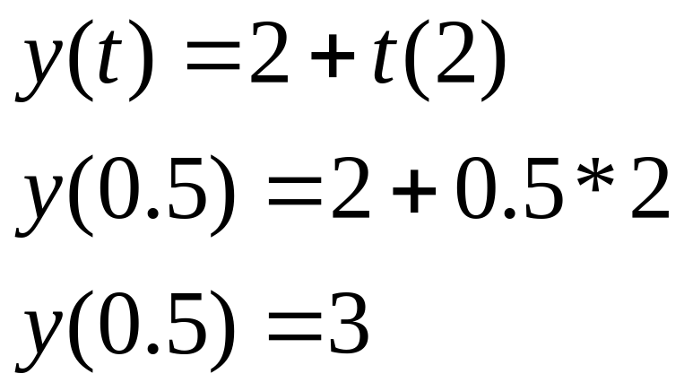
Example: mid-point

Slide 13
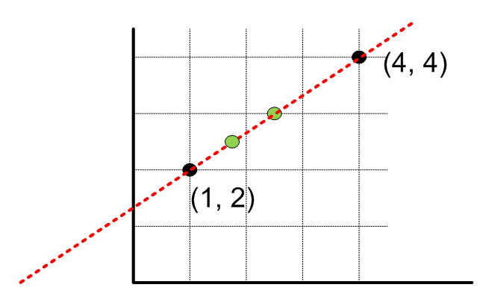
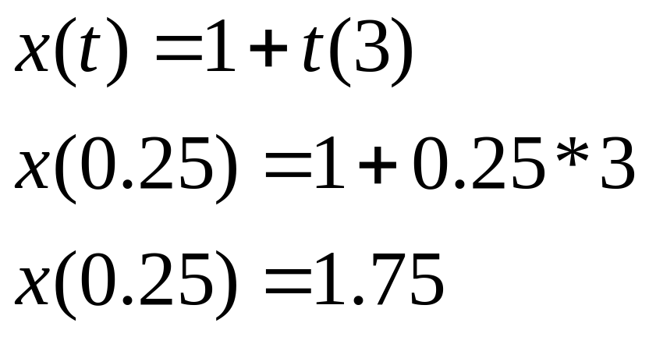
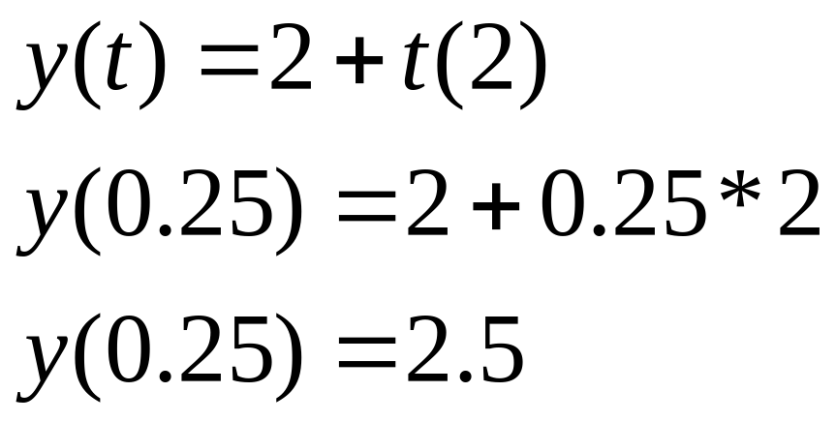
Example: quarter-point

Slide 14
Topic 3
Interpolation

Slide 15
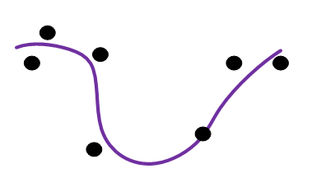
Interpolation
Interpolation is the creation of new data points from a set of known points.
For example, a scatter of points on a graph. From the given points you can calculate the line which has the closest fit

Slide 16
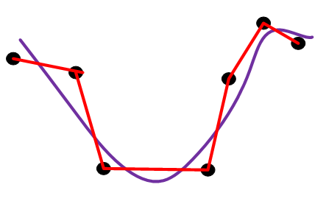
Interpolation
The line could take different forms. For example:
  a straight line which passes through all of the points
  some kind of curve which appears to be a close fit but is allowed to miss the points

Slide 17
Interpolation
Interpolation is the operation whereby you capture the essence of a set of data whilst leaving out the noise.
Interpolation is carried out by creating a function.
A function "in mathematics, [is] an expression, rule, or law that defines a relationship between one variable (the independent variable) and another variable (the dependent variable)." Encyclopædia Britannica
So a function takes an input and calculates an output according to some mathematical rule or operation.

Slide 18
Interpolation
Set of points. Want to draw a line through them, but we want this to be a aesthetically pleasing curve.
Need to calculate points in between our known points. This method is know as interpolation.
Interpolation means to take a set of discrete points at given intervals and generate the continuous function that passes through the points.
Laurent will do interpolation with you in the context of animation.

Slide 19

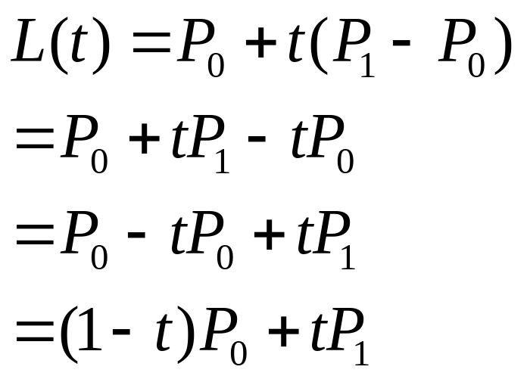
Linear Interpolation
Linear interpolation is usual abbreviated to lerp.
By using the parametric line equation you can calculate any point along the line.
Often rearranged into the following form:

Slide 20
Polynomial interpolation
It is also possible to use polynomial interpolation.
A polynomial expression is an expression involving a sum of powers.
So simply interpolation using a polynomial.
Produces interesting curves, for example curves which are irregular, which perform abrupt changes in direction, or even form knots.

Slide 21
Topic 4
Path Smoothing & Splines

Slide 22
Path Smoothing
There are many ways to interpolate data. I will introduce a method of generating a curve called the Catmull-Rom spline.
I will quickly pass over how it does this, but essentially you generate tangents based on the position of the sample points.
For more details see Van Verthe section 9.6 and Rabin, "A* Aesthetic Optimizations", Games Gems.

Slide 23
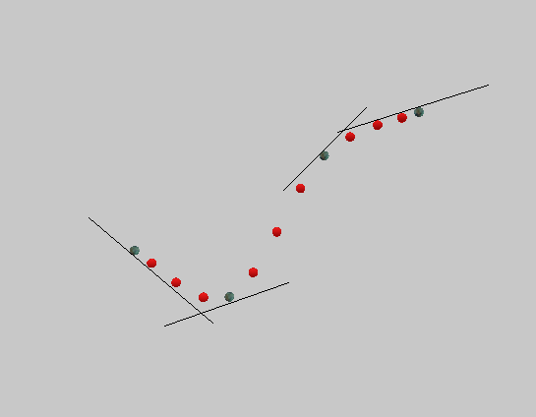
Catmull-Rom spline

Slide 24
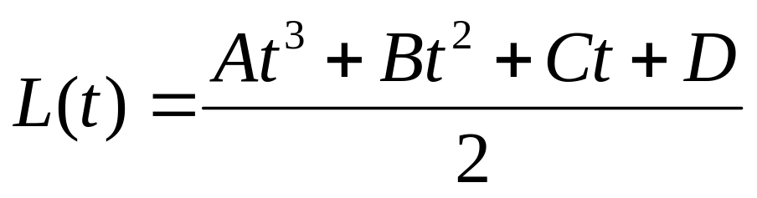
Catmull-Rom spline
Need four points.
The curve is derived for the line between the second and third points.
The line is calculated as a sequence of discrete locations.
The calculation is carried out for each component of the four points.
Bicubic polynomial.

Slide 25
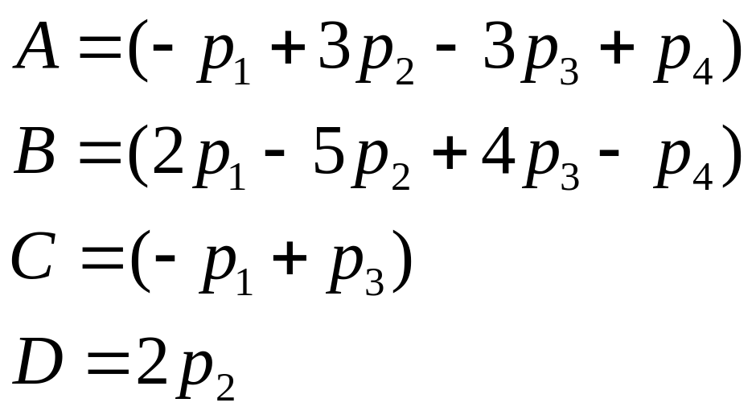
Catmull-Rom spline
Where A, B, C and D are:

Slide 26
Path Smoothing
As with parametric line equations, in practice you will express each of the x, y and z components separately (cf. slide 8 and the examples given on slides 10 - 13.)

Slide 27
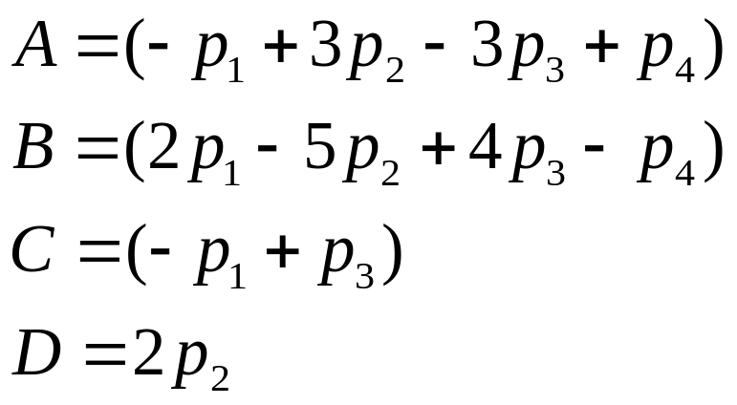
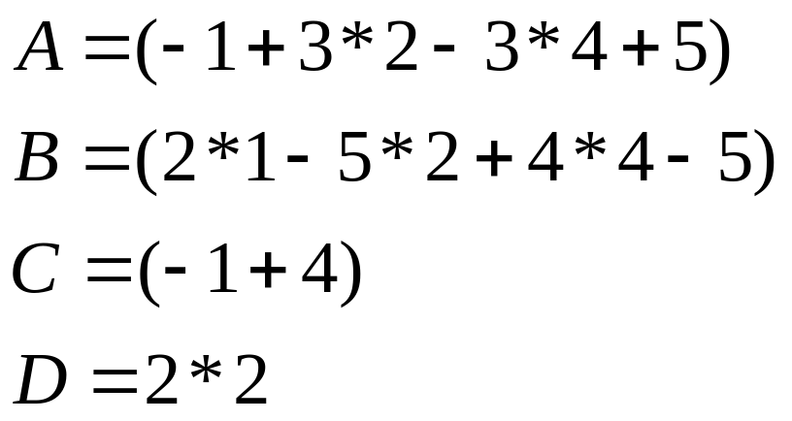
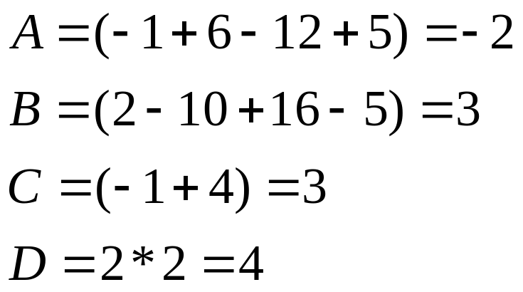
Example
Given 4 points (1, 2), (2, 4), (4, 3) and (5, 6).
Do the calculation first for x:

Slide 28
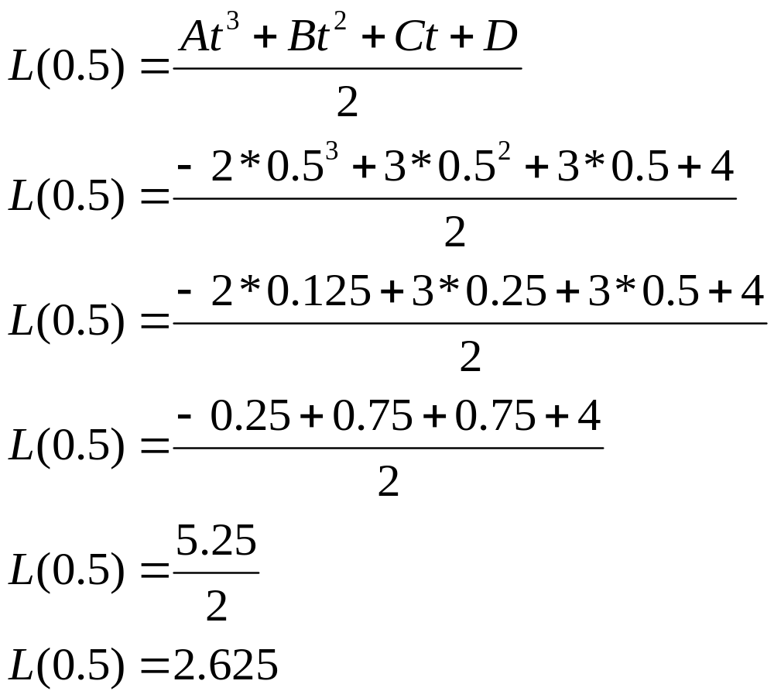
Example
Now plug this into the equation.
If we want the mid-point between B and C then t = 0.5

Slide 29
Catmull-Rom spline
You don't need to derive all of the points of the curve.
An efficiency gain can be made by using predetermined intervals. This allows you to pre-calculate the value of t.
Quarter interval:
Half interval:
Three quarter interval:

Slide 30
Catmull-Rom spline
In order to derive the line between the second and third points (the middle) use all four points.
In order to derive the line between the first and second points (the first third) use the first points twice, i.e. p1 and p2 are the same.
In order to derive the line between the third and last points (the last third) use the last points twice, i.e. p3 and p4 are the same.

Slide 31
Characteristics of Catmull-Rom spline
The curve passes through all of the points.
It is reasonably efficient.
The line is continuous.

Slide 32
Bézier curve
There are a number of other splines: Hermite splines, B-Splines, etc.
A commonly used one is the Bézier spline.
As with all of the splines, the Bézier spline uses polynomial interpolation. A cubic Bézier curve is give using the following forumula:

Slide 33
Characteristics of Catmull-Rom spline
The curve passes through all of the points.
It is reasonably efficient.
The line is continuous.

Slide 34
Characteristics of Bézier spline
The curve touches the first and last points.
The curve is within the convex hull of the control points.

